Slide 1
WATER LEVEL MONITORING SYSTEM USING IoT

Slide 2
Problem statement
We need to consume water in a efficient way.
But in our day to day life water is being wasted in huge amounts.
So we have to think of effective and smart solution for it.
Water wastage is mainly due to improper management.
Due to imbalance of water,people in some areas are struggling a lot.
For reducing water wastage,we have come up with an idea.

Slide 3
Water Level Monitoring System
Here we are using “IOT” in order to use water in an efficient way.
We are using aurdino as the development board.
Water level will be displayed in the lcd to know the level present in the tank
Ultimate aim of this is that the motor will automatically be switched on and off according to the water level.

Slide 4
List of components
Aurdino uno
LCD
Ultrasonic sensor
Bread board
Jumper wires
USB type A to type B cable
Submersible pump
Relay
Buzzer

Slide 5
Working principle of ultrasonic sensor
The ultrasonic sensor module works on the natural phenomenon of ECHO of sound..
we have used Ultrasonic sensor module which sends the sound waves in the water tank and detects reflection of sound waves that is ECHO. First of all we needs to trigger the ultrasonic sensor module to transmit signal by using Arduino and then wait to receive ECHO

Slide 6
PRINCIPLE
Arduino reads the time between triggering and received ECHO. We know that speed of sound is around 340 m/s. so we can calculate distance by using given formula:
Distance= (travel time/2) * speed of sound
Where speed of sound is approximately 340m per second.
Here we have divided the product of speed and time by 2 because the time is the total time it took to reach the obstacle and return back. Thus the time to reach obstacle is just half the total time taken
By using this methods we gets distance from sensor to water surface. After it we need to calculate water level.

Slide 7
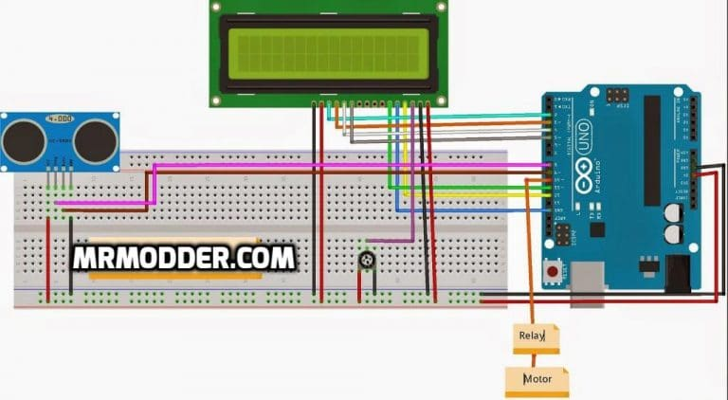
CIRCUIT DIAGRAM

Slide 8
WORKING
We get the distance of water level from the top by using the ultrasonic sensor
The distance that we get from the sensor will be sent to the aurdino and aurdino code helps us to display the level on the LCD
This level is made to operate the motor by using the relay as switch

Slide 9
ADVANTAGES
To reduce the wastage of water that is going waste through the tank
Analyse the usage of water and power that is being consumed
Automatically filling the tank when empty

